Slide 1


Study of the Jobactive Employment Fund program
Jeya, Ron, Steven

Slide 2
Dataset
Jobactive Employment Fund Dataset
Contains the applications of getting employment funds to cover the applicants' costs related to job searching, job training, relocation assistance, medical and mental expenses and et cetera. It consists of demographic details, such as education level, age, race, and Jobactive Stream of the applicants, and the reason for getting the employment fund.

Slide 3
Hypothesis
Certain demographic groups are more prone to unemployment because of a variety of factors; such as Education, Age, Gender, Indigenous status, Homelessness, Ex-offence etc.
Certain amounts of funding should be spent on certain demographic groups to assist them with their job search

Slide 4
Motivation & Summary
We looked at the Jobactive Employment Fund program data due to a data limit and our 'unemployment' definition being individuals who are currently unemployed but are seeking to find employment. This is why we chose to use this dataset rather than general unemployment data.
Explore some of the factors that may potentially influence unemployment and employment of Jobseekers who are part of the Jobactive Employment Fund program, and gain further insights and details into factors such as Education, Age, Indigenous background, Homelessness, and criminal background, etc. We also wanted to analyze government expenditure of Jobseekers within the Jobactive program.

Slide 5
Data Cleanup
Steve to discuss...

Slide 6
Ron's Analysis
Questions:
1. Does the education level of the jobseekers have any relation to unemployment/employment? (Higher education level vs Lower)
Find out education level of each Jobseeker
Find out unemployment length of each Jobseeker for each education level
2. Which age group has the greatest number of Jobseekers and is this tied with their education level?
Compare age group and education levels

Slide 7
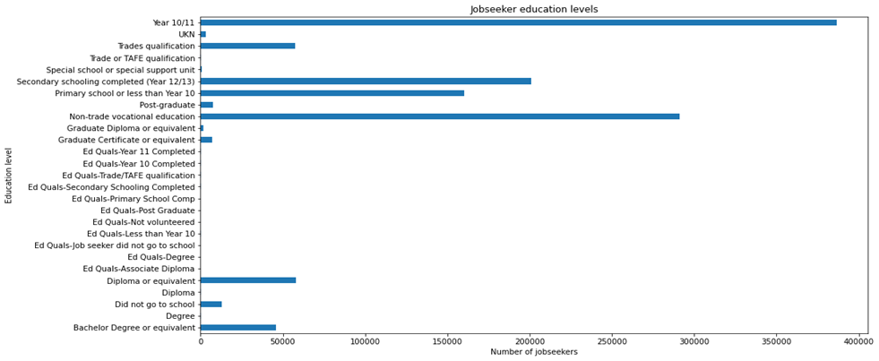
Education Level of each Jobseeker

Slide 8
Education Level vs Unemployment Length (Higher education vs Lower)
Education Level | Unemployment length | No. of jobseekers
Bachelor Degree or equivalent | Under 12 Months | 17784
 | 12 to 23 Months | 9990
 | 24 to 59 Months | 12909
 | 60+ Months | 5201
Education Level | Unemployment length | No. of jobseekers
Year 10/11 | Under 12 Months | 99332
 | 12 to 23 Months | 80549
 | 24 to 59 Months | 126277
 | 60+ Months | 80282
Education Level | Unemployment length | No. of jobseekers
Diploma or equivalent | Under 12 Months | 20579
 | 12 to 23 Months | 12840
 | 24 to 59 Months | 16259
 | 60+ Months | 8329
Education Level | Unemployment length | No. of jobseekers
Primary school or less than Year 10 | Under 12 Months | 36077
 | 12 to 23 Months | 27944
 | 24 to 59 Months | 51930
 | 60+ Months | 44464

Slide 9
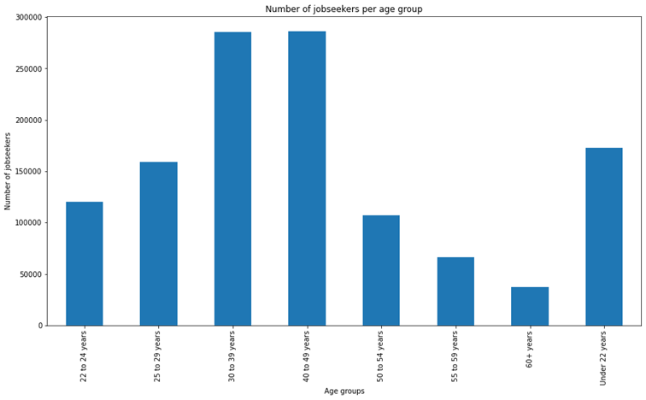
Another demographic: Age Groups

Slide 10
Age Groups (30-39 & 40-49) Education levels
Age Group | Education Level | Count
30 to 39 years | Year 10/11 | 89907
 | Non-trade vocational education | 70874
 | Secondary schooling completed (Year 12/13) | 41694
 | Primary school or less than Year 10 | 37076
 | Diploma or equivalent | 13895
 | Bachelor Degree or equivalent | 10303
Age Group | Education Level | Count
40 to 49 years | Year 10/11 | 91207
 | Non-trade vocational education | 57849
 | Primary school or less than Year 10 | 39921
 | Secondary schooling completed (Year 12/13) | 38957
 | Diploma or equivalent | 16602
 | Bachelor Degree or equivalent | 12406

Slide 11
Discussion of findings
Having a higher education level can assist in staying out of unemployment and seeking employment.
The findings are to be expected.
More expenditure could be directed to funding the education of Jobseekers.

Slide 12
Jeya's Analysis
Indigenous jobseekers funded from 2015 to 2017
What was the count and gender distribution?
How did homelessness and ex-offence affect this group of jobseekers?
Amount spent on Indigenous jobseekers
How much was spent by each category and each stream?
How much did each state spend and what was the average spend?

Slide 13
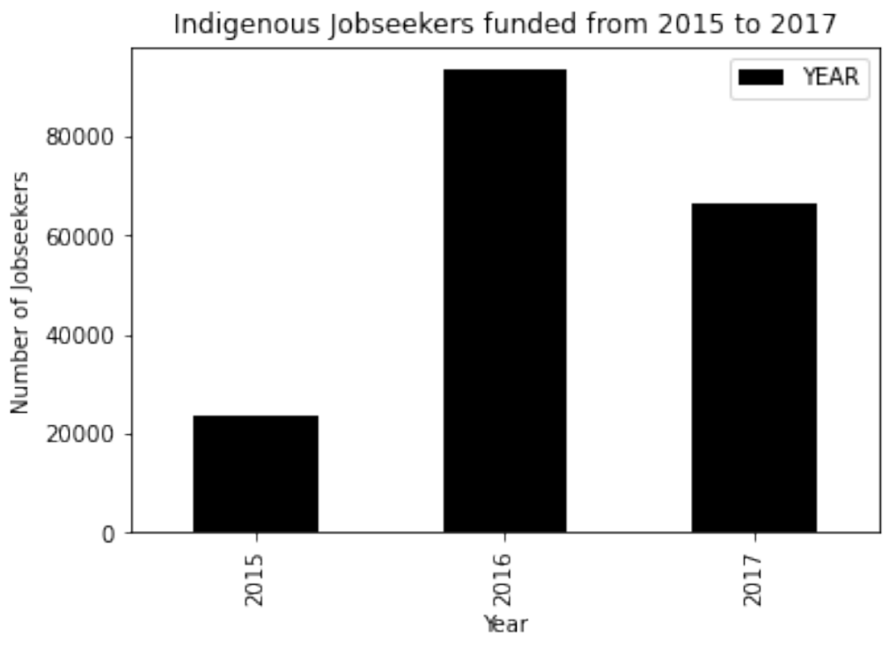
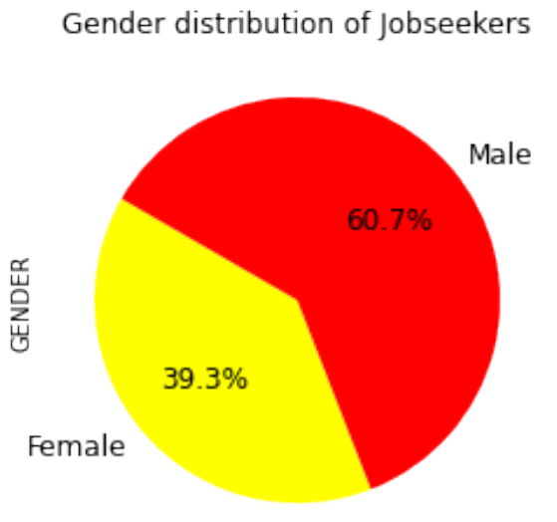
Indigenous Jobseekers – By numbers and Gender 2015 to 2017
There was a significant increase in Jobseekers in 2016 which was 3 times higher than 2015
Majority of the Jobseekers were males

Slide 14
Analysis based on Homelessness and Ex-offence
Year | Homeless | Ex Offenders | Percentage of Homeless | Percentage of Ex-Offenders
2015 | 5304 | 6185 | 22.66% | 26.43%
2016 | 18426 | 23688 | 19.71% | 25.34%
2017 | 12924 | 16331 | 19.37% | 24.48%
Percentage of indigenous homeless people averaged 20.58% over the period of 3 years
Percentage of indigenous people with ex-offences averaged 25.42% over the period of 3 years
There wasn't significant change in the percentage of homeless indigenous people and indigenous people with ex-offence

Slide 15
Categories | Amount Spent | Percentage of amount spent
Clothing and Presentation | $42,351.00 | 23.06%
Professional Services | $30,457.00 | 16.59%
Food, Phone and Petrol Cards/Vouchers | $25,497.00 | 13.89%
Job Seeker Transport | $18,277.00 | 9.95%
Work Related Items | $17,448.00 | 9.50%
Accredited Training | $16,133.00 | 8.79%
Work Related Licencing | $11,266.00 | 6.14%
Tools, Books, Equipment and Mobile Phones | $8,554.00 | 4.66%
Targeted Pre-Employment Preparation | $7,914.00 | 4.31%
Post Placement Support | $2,159.00 | 1.18%
Driving Lessons | $1,607.00 | 0.88%
Medical Expenses | $647.00 | 0.35%
Rent and Crisis Accommodation | $441.00 | 0.24%
Employer Required Training (non-accredited) | $296.00 | 0.16%
Stream C only Assistance | $258.00 | 0.14%
Relocation Assistance | $120.00 | 0.07%
Non-government Programmes - DEPT approved | $103.00 | 0.06%
Work Trials | $47.00 | 0.03%
Non-WfD Activity Costs | $20.00 | 0.01%
Accredited Interpreter Services | $19.00 | 0.01%
PaTH Internship Placement Costs | $2.00 | 0.00%
Analysis by spend Category
Over 50% of the funding allocated went towards
Clothing and Presentation
Professional Services
Food, Phone and Petrol Cards/Vouchers
Only 40% of the funding allocated went towards direct work related expenses

Slide 16
Analysis by spend stream
Streams​ | ​ Amount Spent​ ​ | ​ Percentage of amount spent​
Stream A (highly trained applicants that require minimum support) | $29,484.00 | 16.06%
Stream B (mediumly trained applicants that require additional support for them to be job ready) | $93,489.00 | 50.92%
Stream C (applicants that require support to gain vocational or professional skills to be job ready) | $59,825.00 | 32.58%
Stream Volunteer​ | $816.00​ | 0.44%​
50.92% of the funding went to people under Stream B who were mediumly trained applicants that require additional support for them to be job ready

Slide 17
Total & Average spend by State
State | Number of Jobseekers | Average Amount Spent | Total Amount Spent
QLD | 58694 | $194.45 | $11,413,078.17
NSW | 53294 | $167.49 | $8,926,286.12
WA | 26928 | $163.34 | $4,398,480.34
SA | 16988 | $161.90 | $2,750,418.32
VIC | 14331 | $180.09 | $2,580,806.31
TAS | 6494 | $154.06 | $1,000,494.70
NT | 5973 | $165.34 | $987,587.24
ACT | 914 | $192.74 | $176,167.67
QLD had the highest number of indigenous jobseekers and had the highest average spending over the period of 3 years
ACT had the least number of indigenous jobseekers but had the second highest average spending over the period of 3 years

